Slide 1
Cats are cool Right?
Monday
Friday
Check SUSSED
Also drink too much
Thursday
Tuesday
Look up how to center div
Spam your PAT
Wednesday
Drink too much

Slide 2
Yes they are!

Slide 3
So!
Our node js didn’t want to work
BUT!
Cats!

Slide 4
And as we know…
Productivity
Number of cats

Slide 5
So we made
Cats
+
Todo list

Slide 6
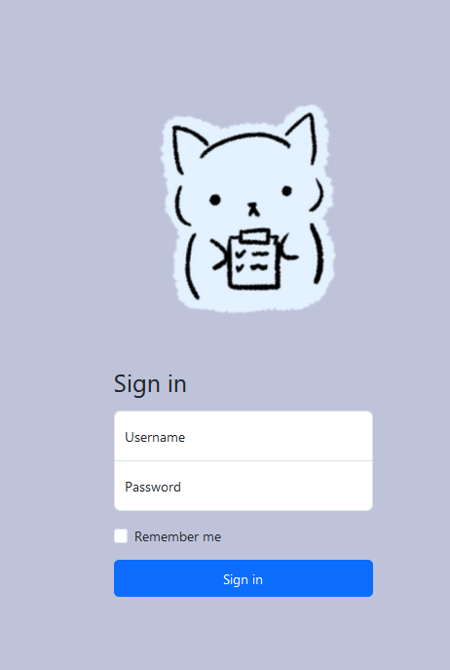
Yes they are!
A sign in page
That works

Slide 7
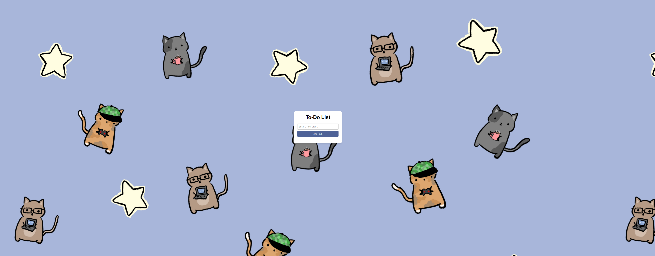
Yes they are!

Slide 8
That’s right
Cats are fucking cool

Slide 9
And here’s a demo

Slide 10
Yeah that’s it

